Slide 1

EasyReg
Checkpoint 1
Universidade de Aveiro - DETI - March 2025
1

Slide 2
Table of Contents
01
02
03
04
Backlog
GitHub/Docker
organization
Backend
inception
Next steps
2

Slide 3
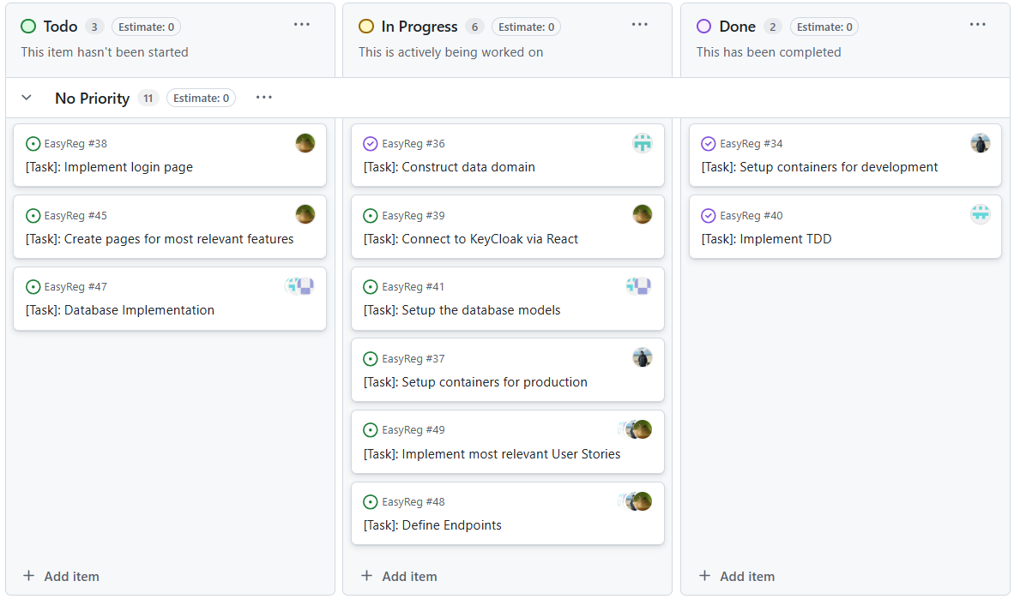
Backlog
3

Slide 4
Data Domain and Docker Containers
ENVIRONMENT
API
FRONTEND
Django
React Native
AUTH
DATABASE
DATABASE
KeyCloak
PostgreSQL
MongoDB
4

Slide 5
BackEnd Inception
  We used Test Driven Development - TDD
  User Stories Tests implemented
  Definition of the models
  Database in need of improvement
5

Slide 6
Next Steps for Milestone 3
April 7th
Continue implementing User stories
Define the models for both databases
Implement Autentication using KeyCloak
Start implementing the mockups for the FrontEnd interfaces
6

Slide 7
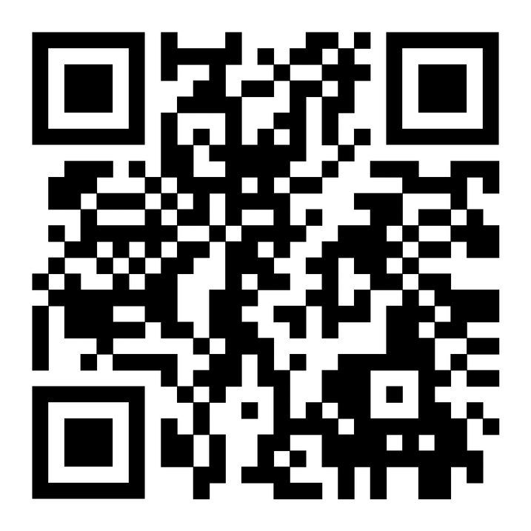
Micro-Site
Thank you!
7

